Slide 1
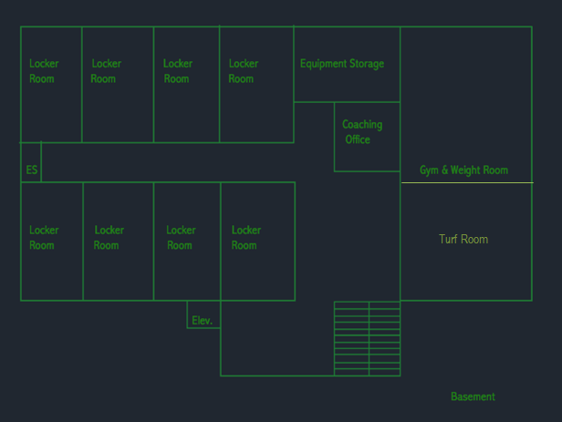
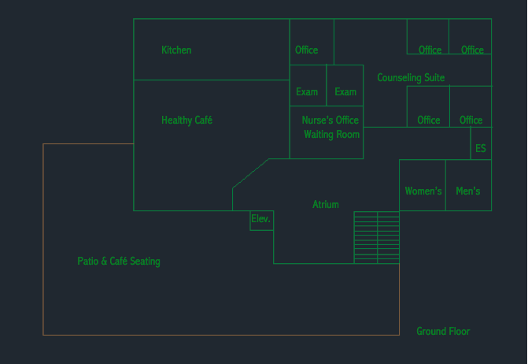
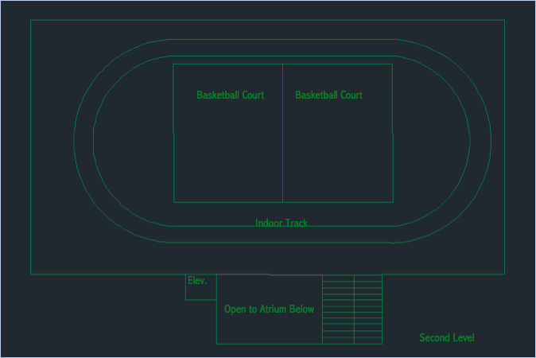
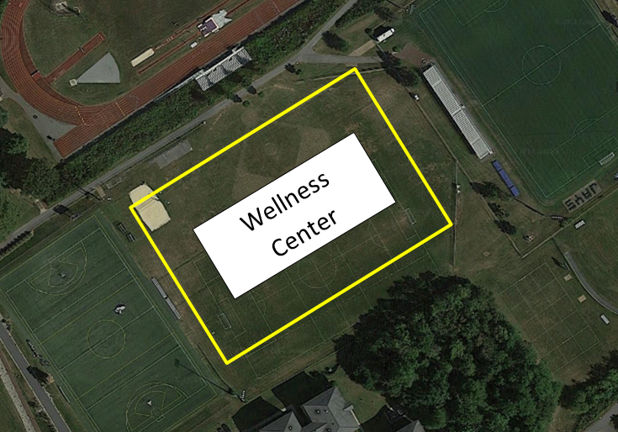
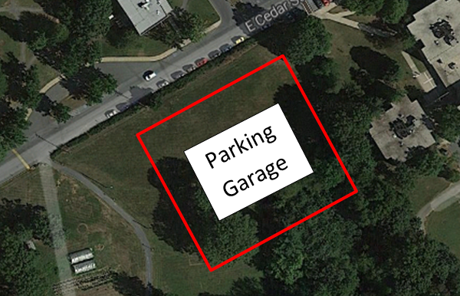
Wellness Center Design
Kelly Bresnowitz, Jamey Hogarth, Rachel Lacek
Dr. Joseph Wunderlich
Introduction
Basement
Ground Floor
Second Floor
Elizabethtown College has been growing since it was opened in 1899. A common problem in colleges and universities is that the enrollment increases faster than the facilities. Now the college is facing difficulty with their athletic and wellness resources running low for the amount of students enrolled. Students in Green Architectural Engineering (EGR 343) have been asked to design a wellness center for the college. It should follow LEED guidelines.
The basement will be home to eight locker rooms to be used by men’s and woman’s soccer and field hockey teams in the fall. Cross country will stay in Thompson. Indoor track will use the locker rooms in winter as well as in the spring. Both men’s and women’s basketball teams, swimming, and wrestling will remain in Thompson. In the spring, baseball, softball, and men’s and women’s lacrosse teams. There will also be one coach/official locker room to be used by the teams that use it through the various seasons. Both men’s and women’s tennis will stay in Thompson. A large storage room with a lot of shelves will be in the basement to store athletic equipment. A turf room is located here for the off seasons of soccer, lacrosse, softball, baseball, field hockey team. This is a better surface for them to practice on than a hardwood floor. A larger weight room will be located here since the Body shop is very small and fills up rather quickly.
Upon entering the wellness center, there will be a patio for people to do school work or enjoy a meal. When entering the wellness center, there will be a fountain. To the right will be another cafeteria, take-out-style, where a meal swipe can be used. The kitchen will be located behind it. There will be additional seating inside to eat, to reduce the crowds in the Marketplace at peak times. This cafeteria is located on the ground floor so that people can go in and out quickly if they are in a rush. Counseling would be moved over to this new wellness center. It is located in the back corner so students that are seen going here will not feel like they are being watched. A nurse’s office will be located here so students do not need to travel down to the Hershey Medical Center to receive attention.
The regulation size indoor track for the track and field team will be located on this floor. It can also be used by any other Elizabethtown College student, faculty, or staff. It is a great alternative to running on a treadmill, which always fill up quickly, especially in the winter months. There will also be room for bleachers for spectators to watch. Inside of the track will be two basketball courts that can only be used for intramural sports or off season training. There will be partitions that can be lowered between and around the track. On one wall there will be a rock wall. Suspended above the track will be a high ropes course. This will be great for on campus activities and sports team bonding. Small storage rooms will be located on this floor for convenience.
Location
The wellness center will be located between the turf field and soccer game field. This way it is not too far away from the center of campus and does not clutter everything. A parking garage will be located across the street from Brinser to provide more parking for staff, students, and visitors of Elizabethtown College.
1
Additional Points
LEED Certification
Atrium at Entrance
Seating and Tables for students to work on school work together
Large Windows for Natural Light
Industrial Look (like Jay Walk)
Green House on Roof
200m Regulation Track
Faculty and Staff get bottom floor in parking garage
Gray Water Utilization
Bike Racks Outside
Reduced Parking Footprint (Parking Garage)
Water Metering
Indoor Water Use Reduction
Outdoor Water Use Reduction
Refrigerant Management
Renewable Energy Production
Storage and Collection of Recyclables
Waste Management
Green Vehicle Preferred Parking (in Parking Garage)
Sunlight Utilization
Tobacco Smoke Control
Acoustic Performance
Innovation
Department of Engineering and Physics Elizabethtown College 2014

